Slide 1



Low Frequency Prototype of Laser Interferometer Suspensions for Gravitational Wave Detection
Presentation By: Yuka Lin and Skylar Kemper
Mentor: Dr. Michele Zanolin (Department of Astronomy & Physics)
Embry-Riddle Aeronautical University
Acknowledgements: Dr. Darrel Smith (Embry-Riddle Aeronautical University), Dr. Anne Boettcher Smith (Embry-Riddle Aeronautical University)

Slide 2
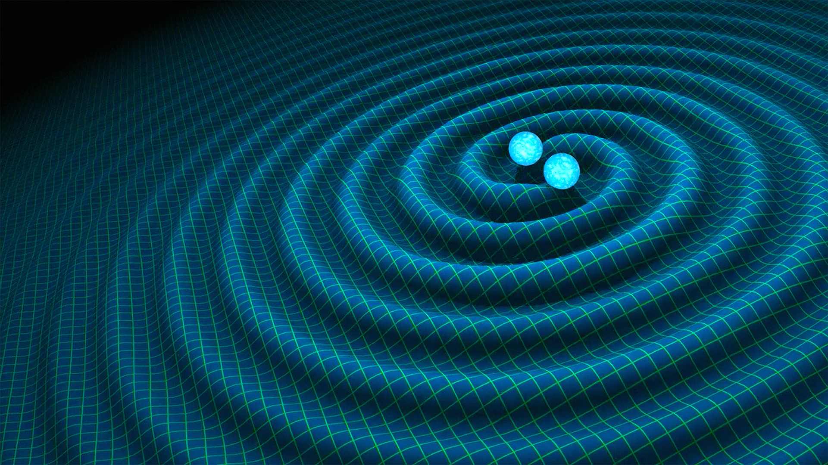
Gravitational-Waves
Artist's impression of gravitational waves generated by binary neutron stars.
Credits: R. Hurt/Caltech-JPL
https://www.researchgate.net/figure/Left-panel-LIGO-Hanford-site-USA-The-two-arms-of-the- interferometer-are-about_fig3_331246187
Artist's impression of gravitational waves generated by binary neutron stars.
Credits: R. Hurt/Caltech-JPL

Slide 3
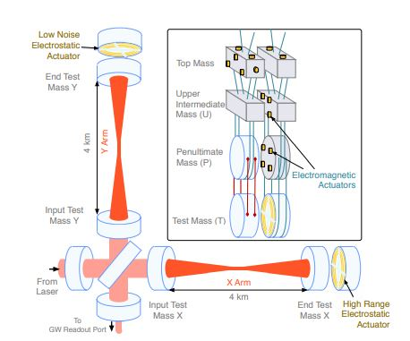
LIGO = Laser Interferometer Gravitational-Wave Observatory
https://www.researchgate.net/figure/Left-panel-LIGO-Hanford-site-USA-The-two-arms-of-the- interferometer-are-about_fig3_331246187
https://arxiv.org/abs/1710.09973

Slide 4
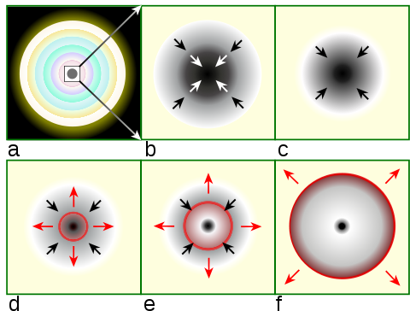
The overall goal of this project: detecting gravitational waves (GW’s) in the low frequency regime (below 10 Hz)
Essentially, this regime is where the supernovae core-collapse and pre-merger binary star mergers are relevant.
https://en.wikipedia.org/wiki/Type_II_supernova

Slide 5
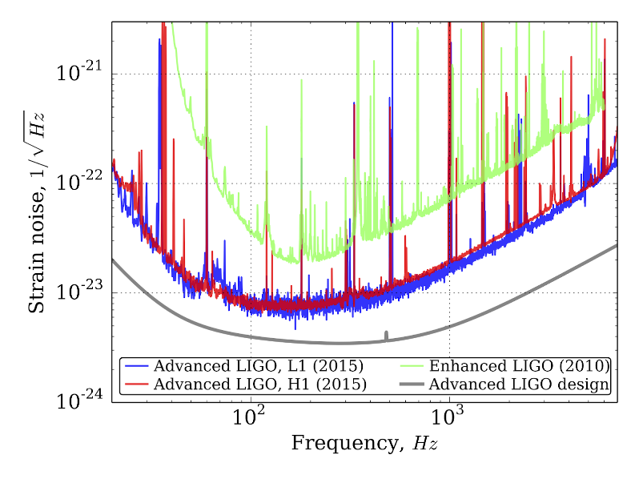
Detector Sensitivity
The graph shows the level of strain noise that LIGO detectors can detect. The lower the lines, the more sensitive the detectors are.
https://arxiv.org/abs/1604.00439

Slide 6
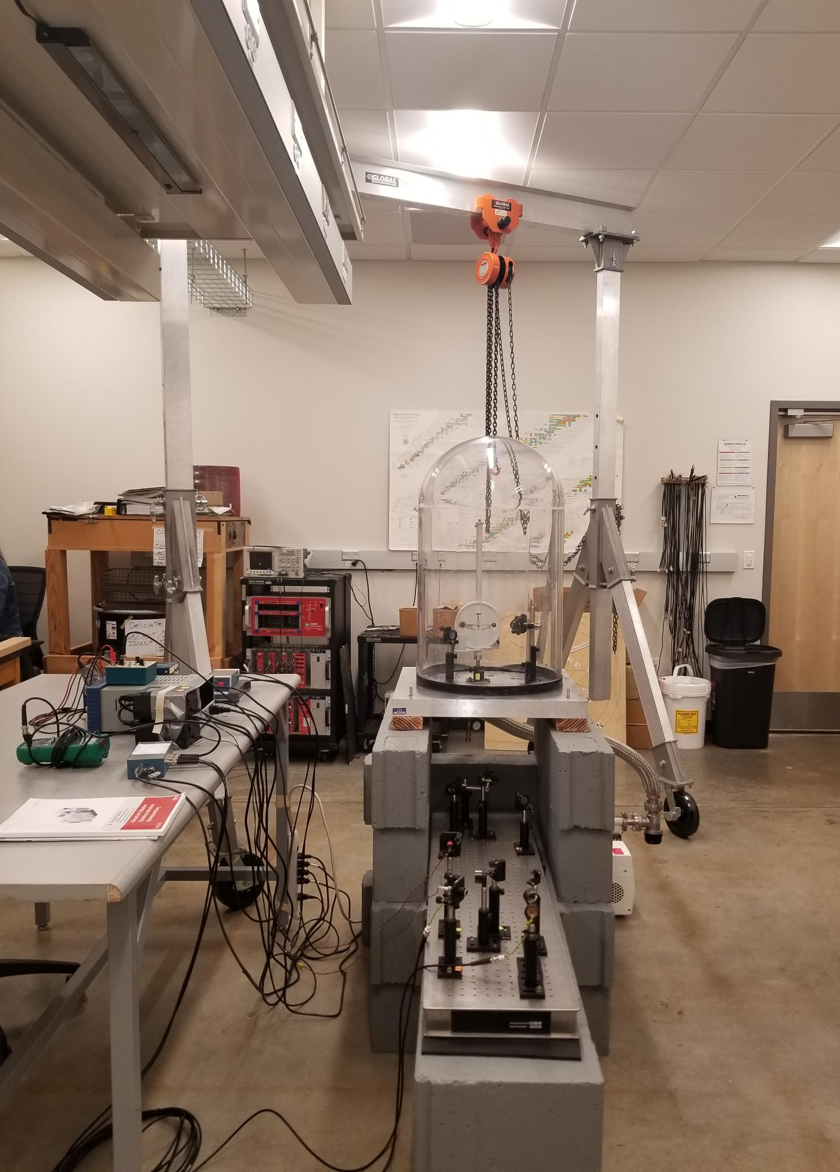
Experimental Model Set-Up
Quick overview of experimental setup:
The torsion pendulum apparatus for this experiment contains two parts:
the actual torsion pendulum balance
a split mirror photodiode system.

Slide 7
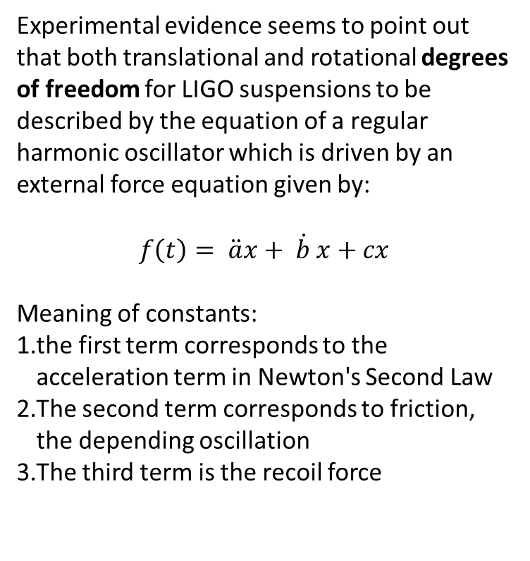
Experimental Model Set-Up
Experimental evidence seems to point out that both translational and rotational degrees of freedom for LIGO suspensions to be described by the equation of a regular harmonic oscillator which is driven by an external force equation given by:
$$f\left(t\right)= \ddot{a}x+ \dot{b} x+cx$$
Meaning of constants:
the first term corresponds to the acceleration term in Newton's Second Law
The second term corresponds to friction, the depending oscillation
The third term is the recoil force

Slide 8
Experimental Model Set-Up
Goals for the project:
Successfully construct a working torsion pendulum which mimics the behavior of the LIGO quadrupole suspension system
Determine the coefficients (a,b,c) for force of the laser, friction, and recoil force
Observe methods for differentiating low frequency torsion from low frequency gravitational wave detections

Slide 9
Looking Ahead:
Troubleshooting the vacuum
Set up and align optics
Train new students
Calibrate equipment
Conduct experiment

Slide 10
References
Martynov, D. V. et al. “Sensitivity of the Advanced LIGO Detectors at the Beginning of Gravitational Wave Astronomy.” Physical Review D 93.11 (2016): n. pag. Crossref. Web. Type ii supernova. (2021, March 28). Retrieved April 02, 2021, from https://en.wikipedia.org/wiki/Type_II_supernova
Viets, A., Wade, M., Urban, A., Kandhasamy, S., Betzwieser, J., Brown, D., . . . Weinstein, A. (2018, March 13). Reconstructing the calibrated strain signal in the advanced ligo detectors. Retrieved April 02, 2021, from https://arxiv.org/abs/1710.09973

Slide 11
Questions?

